Slide 1
Identity Resolution System
A brief survey

Slide 2




















CDP-players (source : https://www.cdpinstitute.org/)
: https://www.cdpinstitute.org/)

Slide 3

















CDP-players (source : https://www.cdpinstitute.org/)

Slide 4
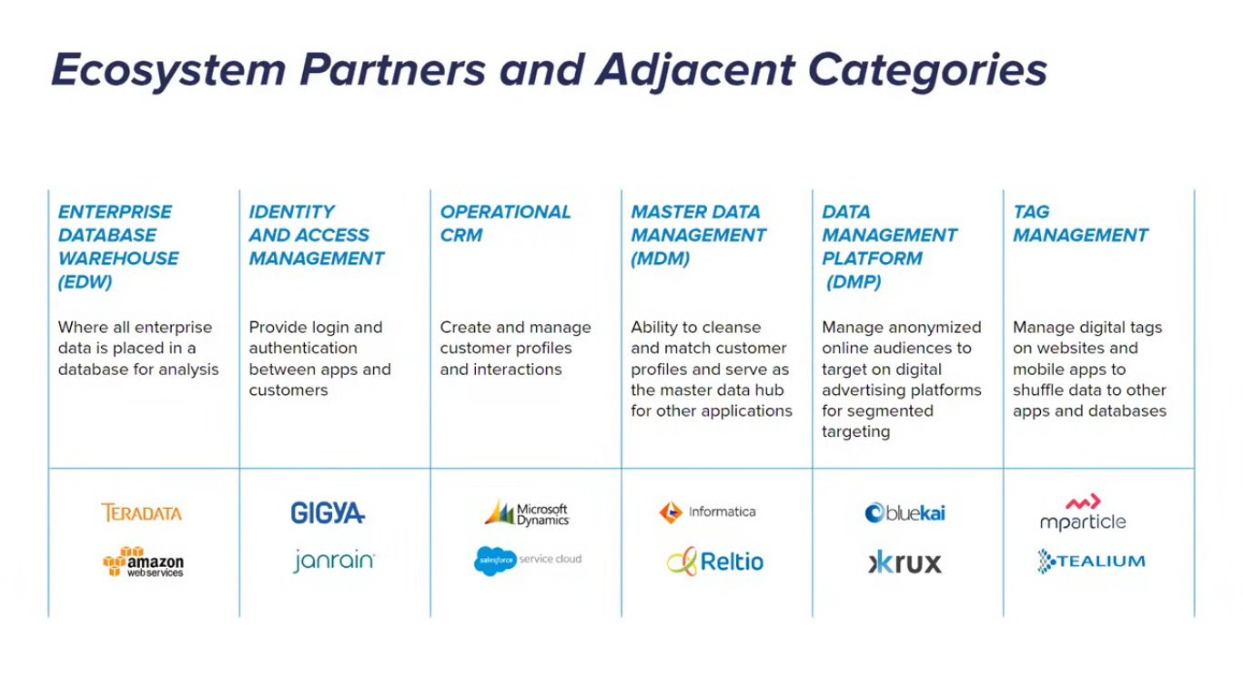
Why CDP?
CDP handles needs in a unified way which is not taken care by the following systems:

Slide 5
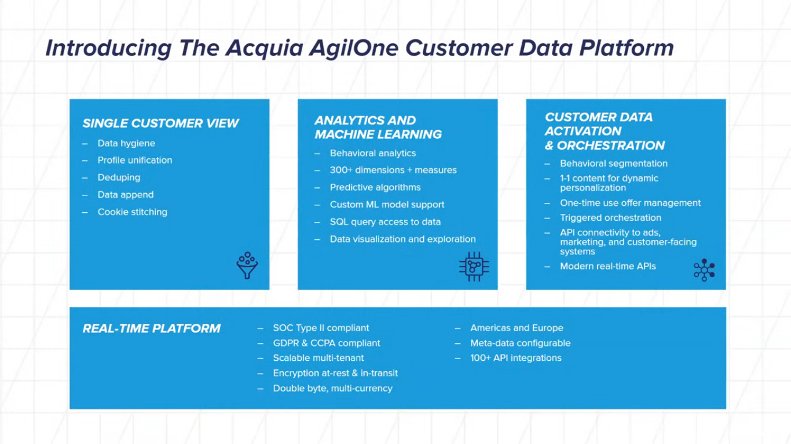
CDP systems in use - Acquia AgilOne CDP

Slide 6
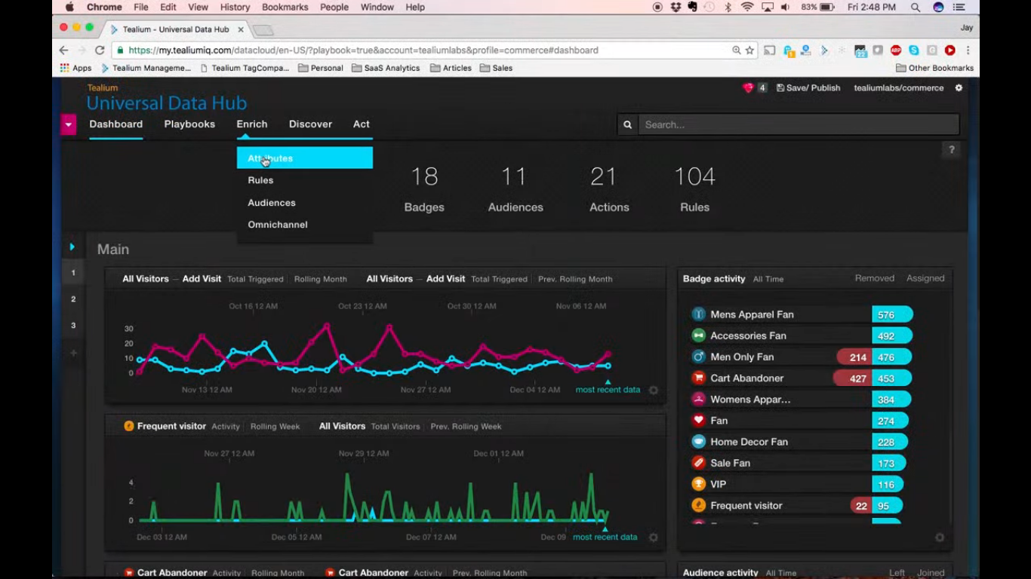
CDP systems in use - Tealium Universal Data Hub

Slide 7







Our initial system design (shared by Dhana)
Events
Deterministic
Probabilistic
Data Lake
[HDFS/Cassandra]
Identity Management Service
Unified Profile Service
Kafka
Sync
Derived Attrs
Schema Service
Vertica
Segmentation
Widgets
Funnels
Cohorts
Predictive Analytics

Slide 8
Identity Resolution System - Introduction
Identity resolution is a process of semantic reconciliation that determines whether a single identity is the same when being described differently. The goal of resolution is to detect duplicate identity records that refer to the same individual in the real world. ( source for the following slides - A framework of identity resolution: evaluating identity attributes and matching algorithms - https://link.springer.com/article/10.1186/s13388-015-0021-0 )

Slide 9
Identity Resolution - Problem Statement
Given a set of identity references, R = {r _{i} }, where each reference r is described by a set of attributes r.A ₁, r.A ₂, …, r.A _{l} . These references correspond to a set of unknown individual E = {e _{i} }. Due to certain reasons (e.g., entry errors, duplicates or deceptions), multiple references may be co-referent to the same underlying individual e. We use r.E to refer to the individual to which reference r refers to. Each reference r may have participated in some incident(s) (e.g., a financial transaction, a criminal misconduct, a terrorist attack) and each incident may involve one or multiple references. We use a set of hyper-edges H = {h _{i} } to represent all incidents. Each incident is a hyper-edge that connects multiple references. Each hyper-edge h can also be described by a set of attributes h.B ₁, h.B ₂, …, h.B _{m} . We use h.R to denote the set of references involved in h. We use r.H to denote the set of hyper-edges in which r participates. In addition, the participation of r in h can be described by a set of attributes r.h.C ₁, r.h.C ₂, …, r.h.C _{n} . The objective is to uncover the hidden set of individuals E = {e _{i} } and the entity labels r.E for all references given the observations of the references and their involved hyper-edges.

Slide 10
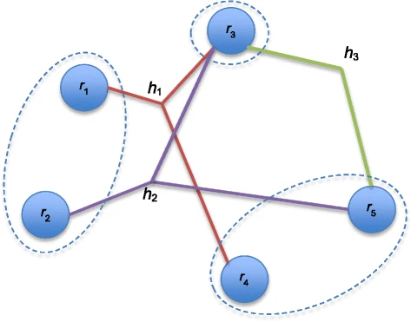
A graphic view of the identity resolution problem

Slide 11

Identity attributes - Personal identity attributes

Slide 12
Identity attributes - Social behavior attributes

Slide 13

Identity attributes - Social relationship attributes

Slide 14
Aggregated similarity score

Slide 15

Matching Algorithms - Pairwise Comparison

Slide 16

Matching Algorithms - Transitive Closure

Slide 17

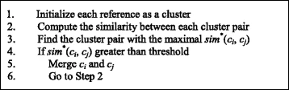
Matching Algorithms - Collective Clustering

Slide 18
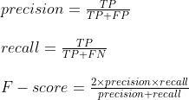
Precision, Recall, F-score

Slide 19
So it all boils down to this...
Defining, mapping and creating the above algorithm for our needs. Specifically, mapping the profile data and event data to the appropriate entities and hyper-edges and their attributes is the main task to be taken care of depending on whatever data we have.

Slide 20
Further resources that I am looking into...
https://kb.informatica.com/proddocs/Product%20Documentation/2/IIR_953_DesignGuide_en.pdf
https://marketing.toolbox.com/articles/what-is-identity-resolution-definition-process-advantages-with-examples
https://idk.dev/building-a-customer-identity-graph-with-amazon-neptune/
https://docs.adobe.com/content/help/en/device-co-op/using/device-graph/links.html

Slide 21
THANK YOU.

